Slide 1
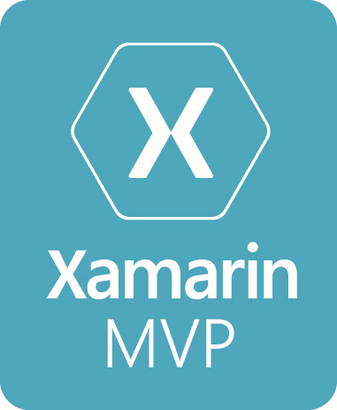


Azure and the Internet of Things
Allan Pead
@adpead
adpead@gmail.com
Xamarin MVP, Microsoft MVP, Xamarin Insider

Slide 2
The Internet of things (IoT) is the inter-networking of physical devices, vehicles (also referred to as "connected devices" and "smart devices"), buildings, and other items embedded with electronics, software, sensors, actuators, and network connectivity which enable these objects to collect and exchange data.

Slide 3


Slide 4
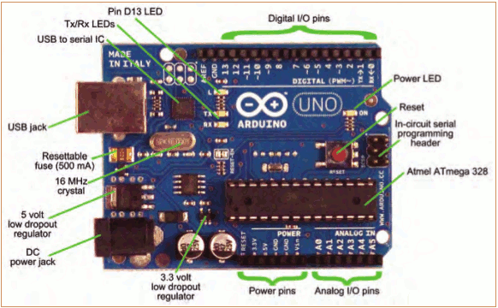

Slide 5
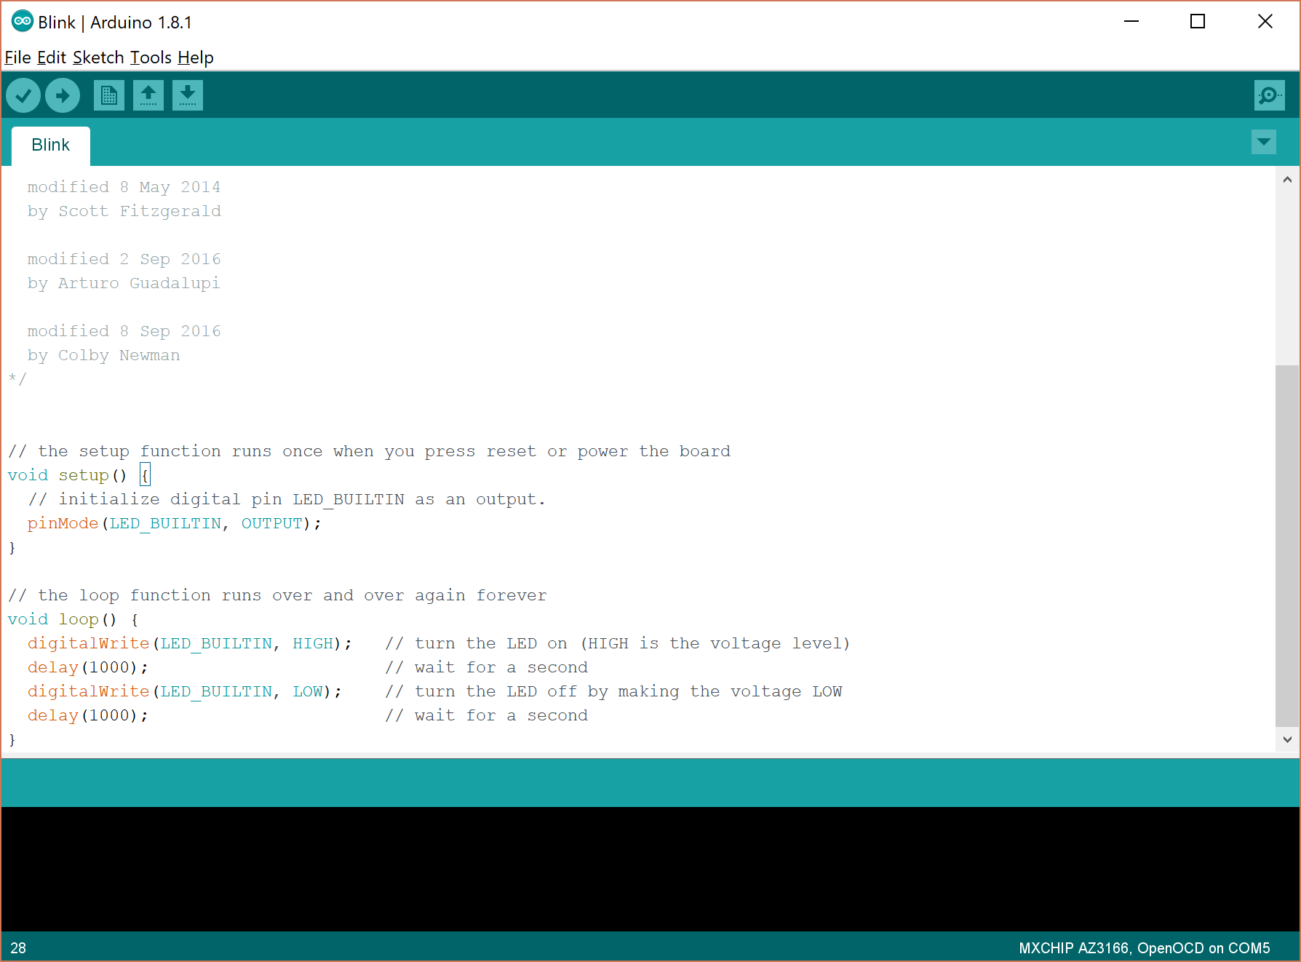
https://www.arduino.cc/

Slide 6


Slide 7
Netduino
Open Source Hardware
.NET Micro Framework
C#
Visual Studio 2015 (2017 extension in progress) Visual Studio for the Mac
http://developer.wildernesslabs.co

Slide 8
Extension

Slide 9


Slide 10
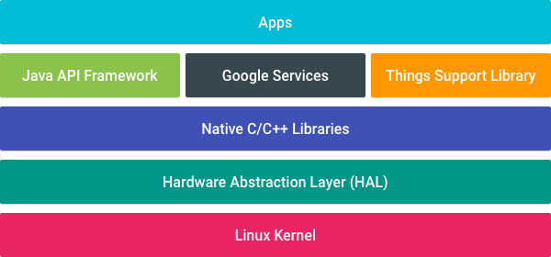
Android Things
Android Things makes developing connected embedded devices easy by providing the same Android development tools, Android framework, and Google APIs
Now in Preview 0.51

Slide 11
Things Support Library
Peripheral I/O API
The Peripheral I/O APIs let your apps communicate with sensors and actuators using industry standard protocols and interfaces. The following interfaces are supported: GPIO, PWM, I2C, SPI, UART.
User Driver API (GPS, HID, Sensors, Audio)
User drivers extend existing Android framework services and allow apps to inject hardware events into the framework that other apps can access using the standard Android APIs.
Notes:
Universal Async Receive tranmit
Serial Peripheral Interface – serial
I2C is a serial bus, master slave
PWM Pulse Width Modulation. GPIO General Purpose Input and output.

Slide 12
Behavioral Changes
Core application packages
Android Things doesn't include the standard suite of system apps and content providers. Avoid using common intents as well as the following content provider APIs in your apps: CalendarContract, ContactsContract, DocumentsContract, DownloadManager, MediaStore, Settings, Telephony, UserDictionary, VoicemailContract
Displays are optional
Google Play Services partially available
Home activity support
Android Things expects one application to expose a "home activity" in its manifest as the main entry point for the system to automatically launch on boot.

Slide 13
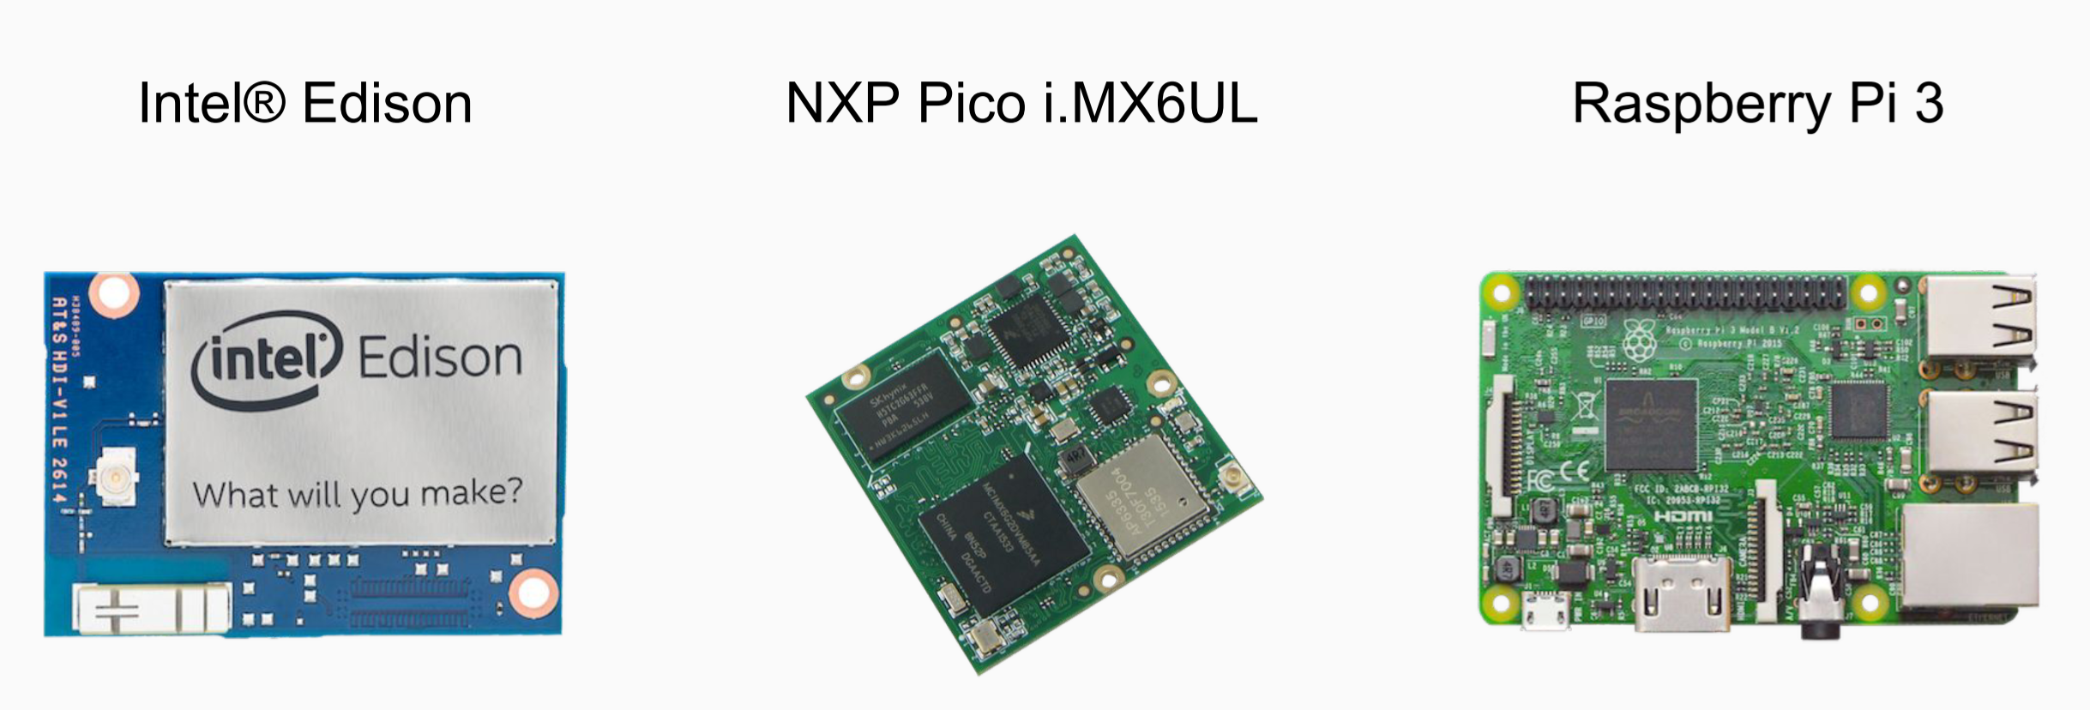
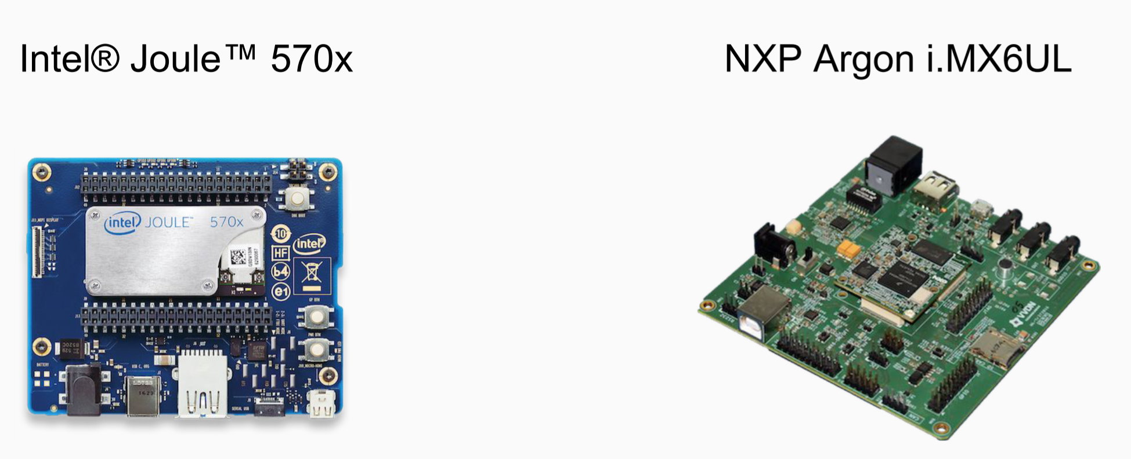
Development Boards

Slide 14
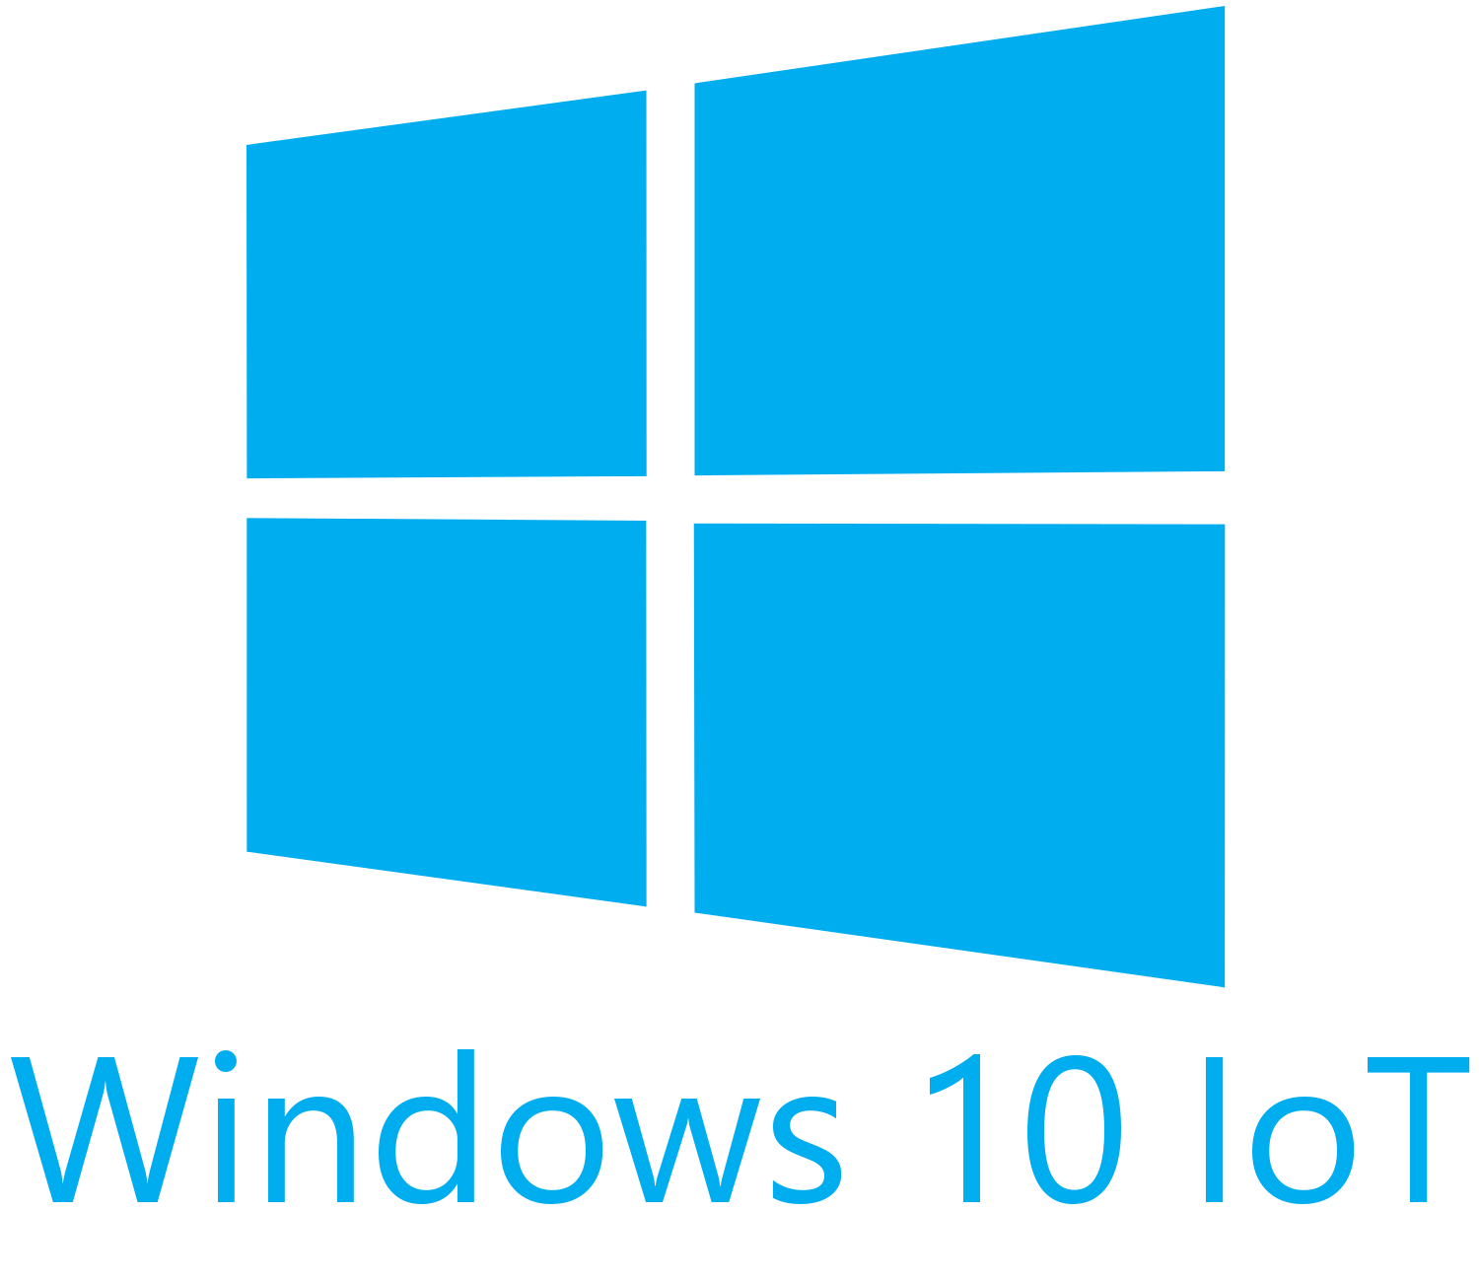

Slide 15
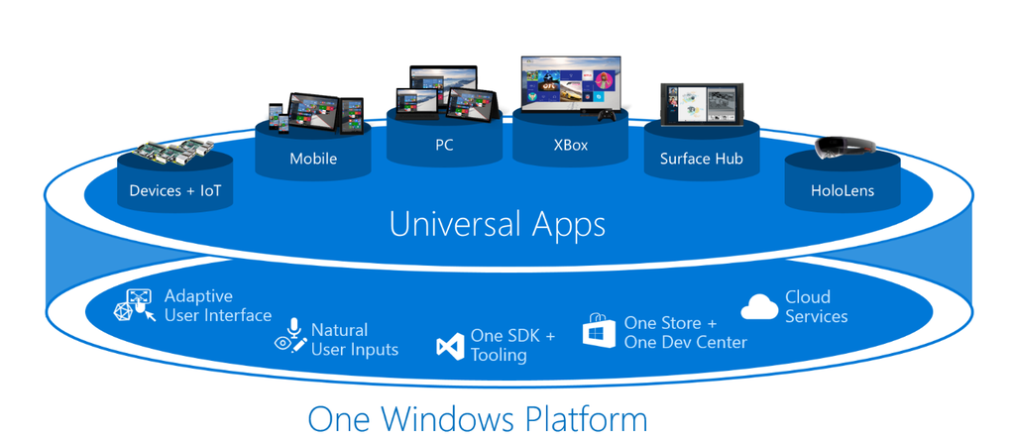
One Windows Platform

Slide 16
Windows 10 IoT Core
C#
XAML
UWP
Azure IoT Device Management
Cortana support out the box
Remote Display

Slide 17
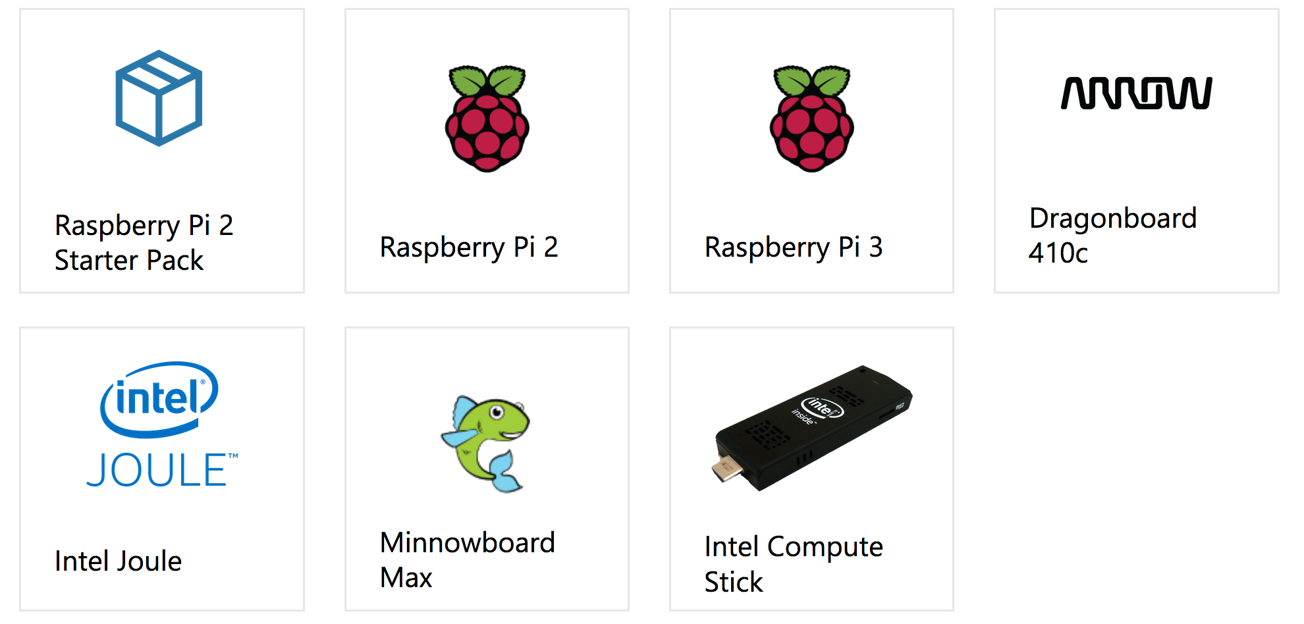
Development Boards

Slide 18
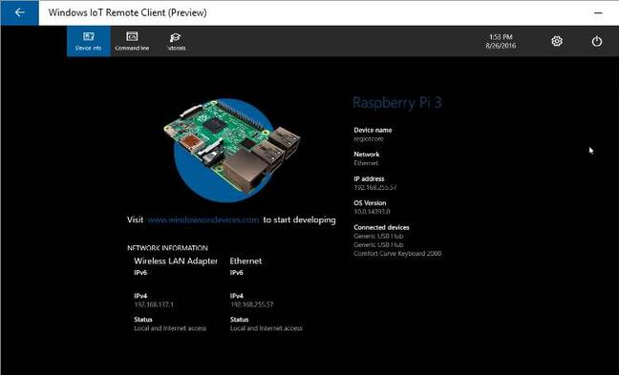
Remote Client

Slide 19

IOT

Slide 20
Xamarin Iot
IoT for all things Linux
Support for devices, not supported by Android Things and Windows 10 Iot
Cross Platform components
Visual Studio 2017 Preview or Visual Studio for Mac

Slide 21
Getting Started
A device with a Linux Distribution
SSH Enabled
Visual Studio 15.4 Preview with Xamarin Out of Band Updater or Visual Studio for the Mac Alpha

Slide 22
Extension

Slide 23
Remote Device

Slide 24
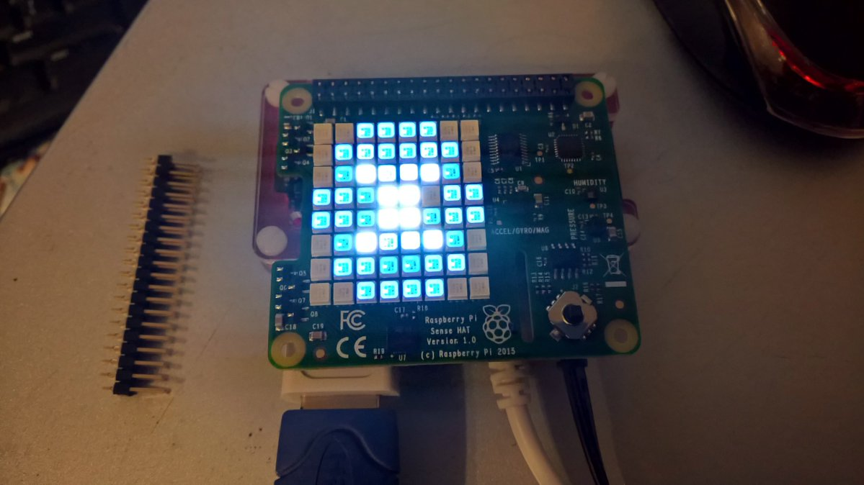
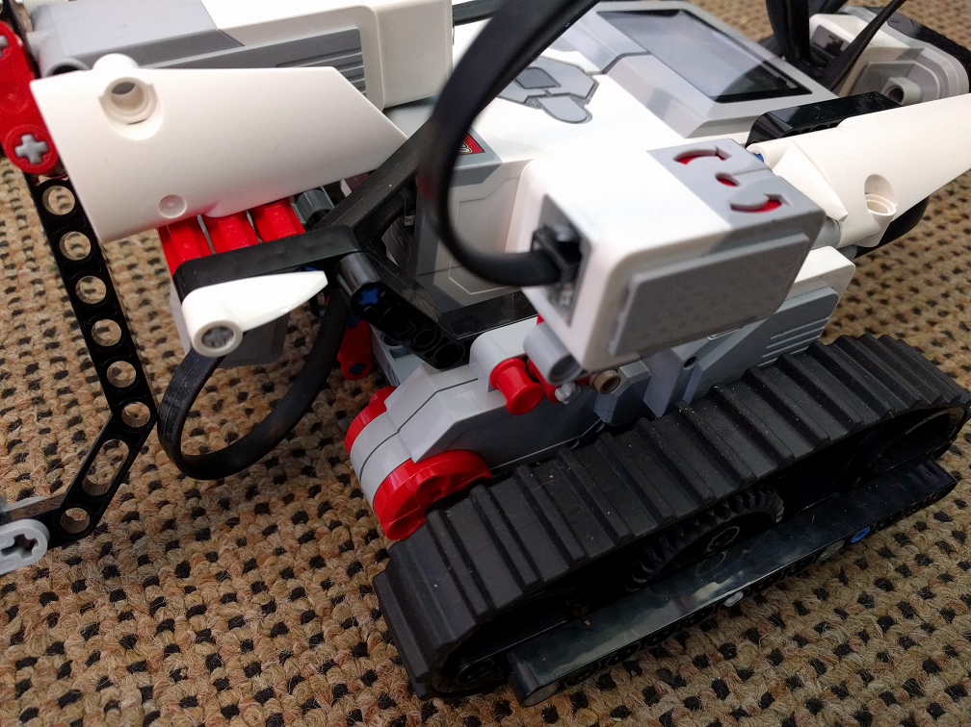
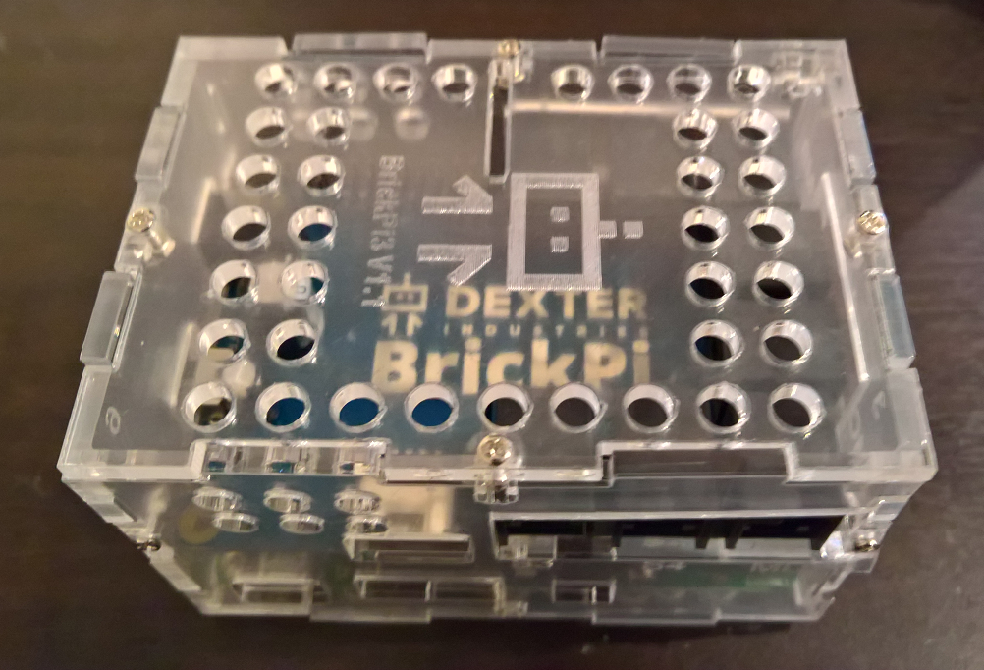

Device Support (Anything Linux based)

Slide 25
What can I do in Visual Studio?
.NET MF (Micro Framework) (eg. Netduino)
Arduino
Visual Micro
Visual Studio Code (Arduino extension is now Open Source)
Windows 10 Iot Core
Android Things
Xamarin Iot

Slide 26
Arduino
Visual Micro: http://www.visualmicro.com/
Visual Studio Code Extension: https://blogs.msdn.microsoft.com/iotdev/2017/07/06/visual-studio-code-extension-for-arduino-is-now-open-sourced/

Slide 27
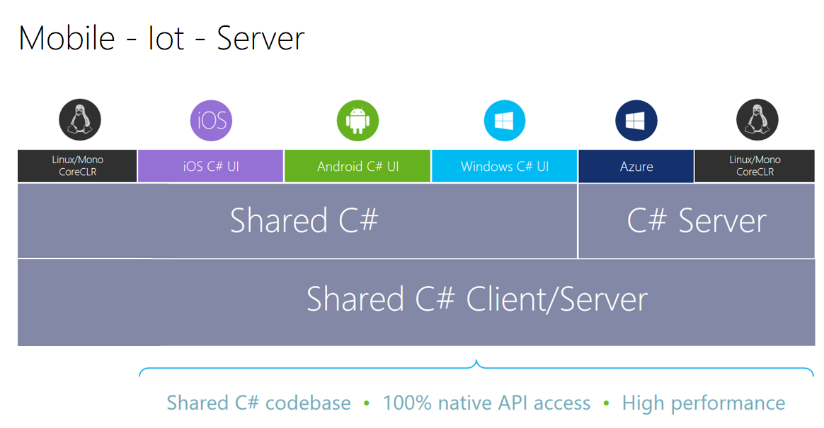

Slide 28
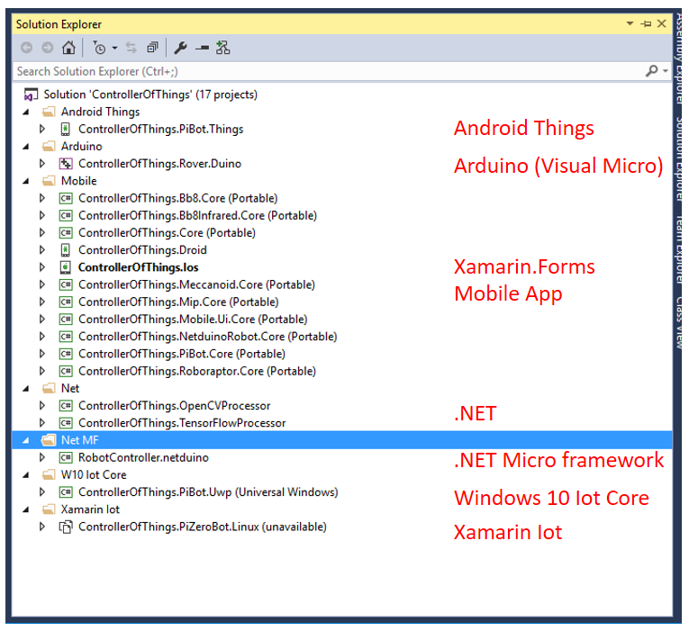

Slide 29


Slide 30
Azure IoT Hubs
Establish bi-directional communication with billions of IoT devices
Work with familiar platforms and protocols (standard and custom protocols, including HTTP, Advanced Message Queuing Protocol (AMQP), and MQ Telemetry Transport (MQTT)
Authenticate per device for security-enhanced IoT solutions

Slide 31
Demo
IoT Device using Hubs

Slide 32
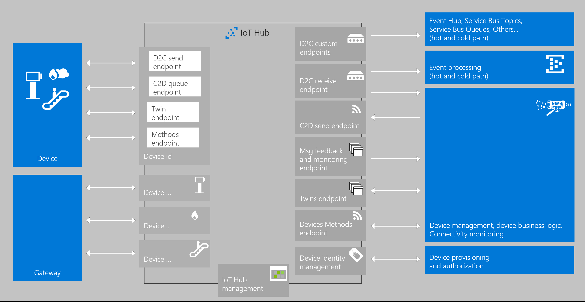

Slide 33
Getting Started with Azure IoT Hub
Create an Azure IoT Hub
Create Device Identities
Use the client SDKs (service and device)
Use the dev tools to debug/monitor
Play with the Azure IoT Starter Kits

Slide 34
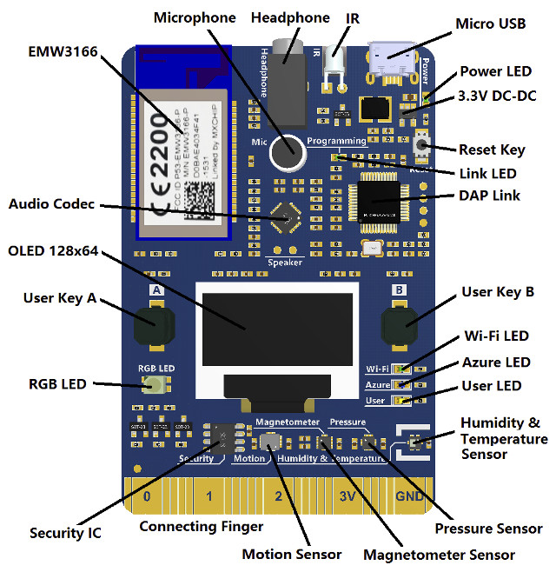
MXChip Kit: https://microsoft.github.io/azure-iot-developer-kit/

Slide 35
Creating an Azure Iot Hub
Azure Portal
https://portal.azure.com
ARM template
https://azure.microsoft.com/en-us/resources/templates/
Azure CLI
https://github.com/Azure/azure-cli (v2.0 Python)
https://github.com/Azure/azure-xplat-cli (v1.0 Node.js)
Powershell
https://docs.microsoft.com/en-us/powershell/azureps-cmdlets-docs/

Slide 36
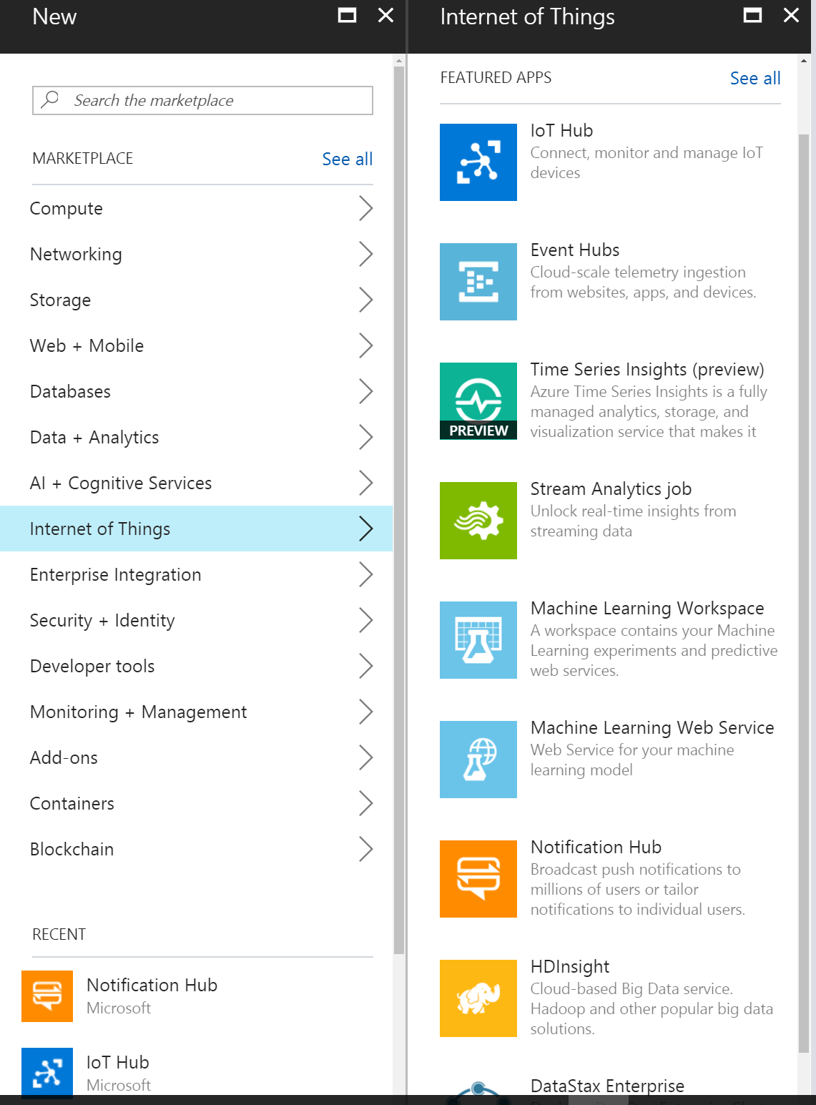
Azure Internet of Things

Slide 37
Azure Iot Hub Developers tools
IoTHub-explorer : node based CLI
npm install -g iothub-explorer
Device Explorer: Windows app
Installer in releases of github.com/azure/azure-iot-sdk-csharp
Device discovery CLI
npm install -g device-discovery-cli
IoTHub Diagnostics tool
npm install -g iothub-diagnostics
Azure IoT Toolkit Extension for Visual Studio Code
Look for « Azure IoT Toolkit » in the VS Code extensions library
Arduino Extension for Visual Studio Code
Look for « Arduino » in the VS Code extensions library

Slide 38
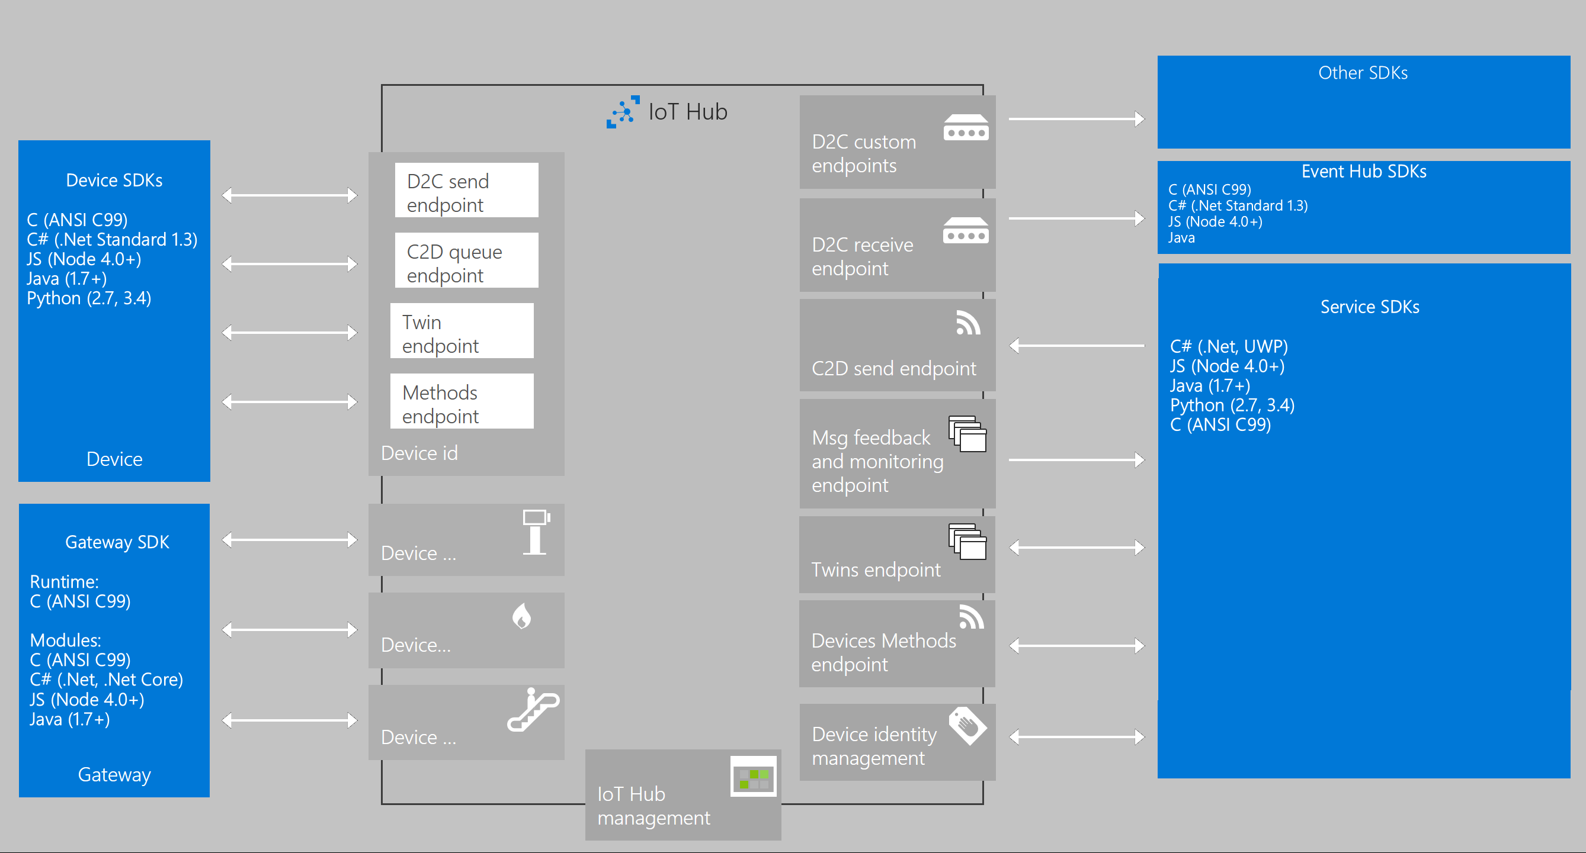
SDKs

Slide 39
Device SDKs platform/OS support
Android (Java or Xamarin)
Arduino
Debian Linux (v 7.5)
ESP8266
Fedora Linux (v 20)
FreeRTOS
iOS (Xamarin)
mbed OS (v 2.0)
OpenWRT
Raspbian Linux (v 3.18)
STM32
TI RTOS
Ubilinux (v3.0)
Ubuntu Linux (v 14.04)
Windows Desktop (7, 8, 10)
Windows IoT Core (v 10)
Windows Server (v 2012 R2)
Yocto Linux (v 2.1)
… and more

Slide 40
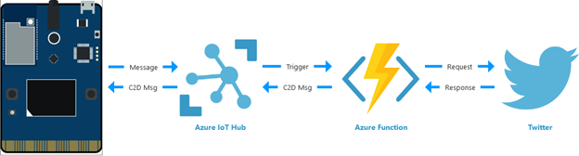
Azure Hubs

Slide 41
Demo
MX Chip Azure Iot Kit Twitter Demo
Azure Functions
Visual Studio Code

Slide 42
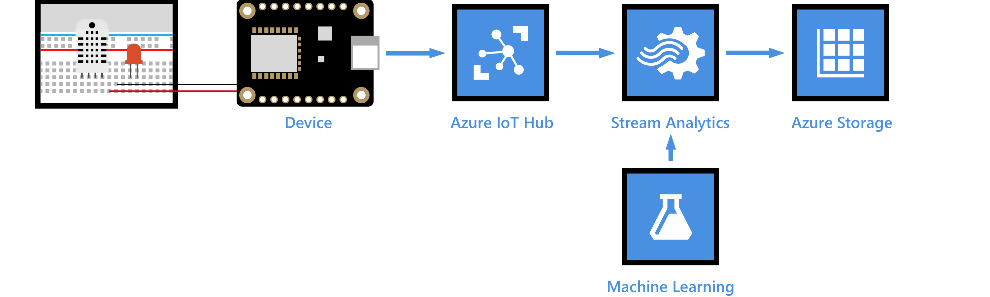
Azure Hubs

Slide 43
Demo
MX Chip Azure Iot Kit Weather Prediction Demo
Azure Stream Analytics
Azure Iot Hubs
Azure Machine Learning

Slide 44
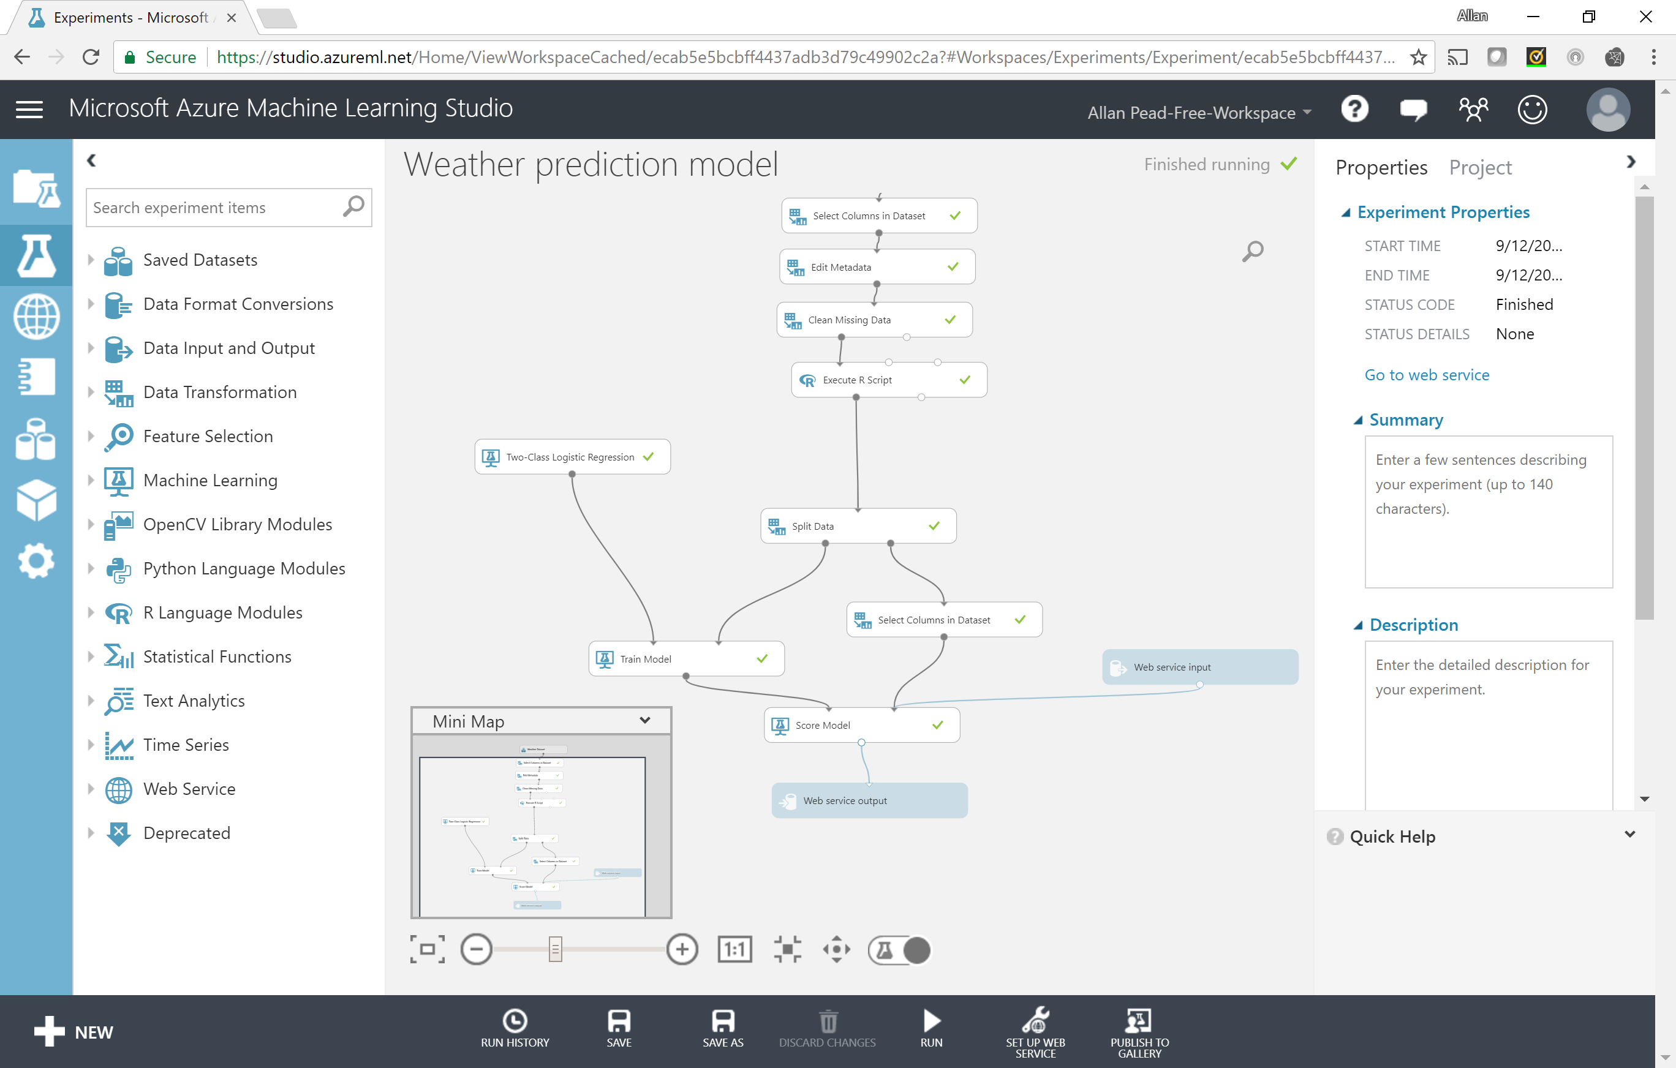
Machine Learning

Slide 45
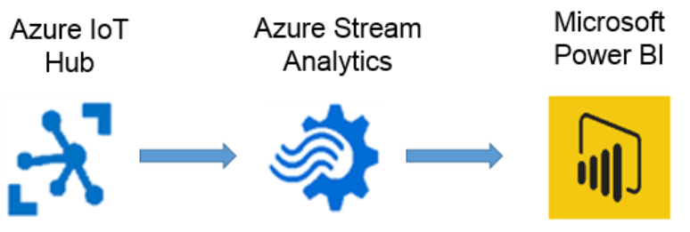
Azure Hubs

Slide 46
What did we cover?
IoT Devices
Azure IoT Hubs
Azure Stream Analytics
Azure Machine Learning
Power Bi

Slide 47
Learn More about IoT
Android Things
https://developer.android.com/things/hardware/index.html
Xamarin IOT
https://developer.xamarin.com/guides/cross-platform/iot/
Visual Studio Code Arduino Extension
https://marketplace.visualstudio.com/items?itemName=vsciot-vscode.vscode-arduino
Azure Iot Hubs
https://docs.microsoft.com/en-us/azure/iot-hub/
https://docs.microsoft.com/en-us/azure/iot-hub/iot-hub-weather-forecast-machine-learning

Slide 48
Learn Xamarin
Local Slack Community
https://zatech.slack.com #xamarin
Xamarin Learning Resources
https://developer.xamarin.com/guides/
Xamarin University
https://www.xamarin.com/university
Learn and share with your local community
Xamarin User Groups
Cape Town (@CTXUG)
Johannesburg (@GXUGSA)
Durban (@DXUGSA)
Allan Pead
Xamarin MVP, Microsoft MVP,
Xamarin Insider
Email: adpead@gmail.com
Blog: http://www.explorationspace.co.za
Twitter: @adpead

